Slide 1
API Management, PDS and FHIR
Tony Heap, Product Owner, API Management

Slide 2
Problem space
“we decided not to proceed with the project”
“too protracted”
“i think the biggest pain was getting set up in the first place”
“we've never assumed integration would be easy ... but we've found it consistently harder than it should be”

Slide 3
Pain points
Learning
Design and build
Testing
Assurance
Help and support
Docs hard to find
Unclear
Incomplete
Inconsistent
Complex APIs
Security hard
Environments not internet-facing
Test suites have issues
Bugs
Protracted
Slow
Complex
Slow
Relies on heroes
No single point of contact

Slide 4
Product vision
Make integration easier
…for external and internal developers
…with a one-stop API Platform
…that is modern, industry best-practice and value for money

Slide 5
Users and needs
External software developers
Understand API delivery lifecycle
Have a platform to build on
Internal software developers
Coders
Testers
Product Owners
Read spec
Test code
Learn how testing works
System test
Learn how to integrate
Learn about APIs
Understand API capabilities
Understand auth
Get help and support
Get help and support
Managers
Learn how assurance works
Register apps
Understand end-to-end process

Slide 6
Types of software
GP software
Trust software
NHS App
clinicians
smartcard
clinicians
unattended use
smartcard
citizens
NHS Login
Pharmacy software
pharmacists
smartcard
Social care software
care workers
out in the field
Disruptive software
for citizens

Slide 7
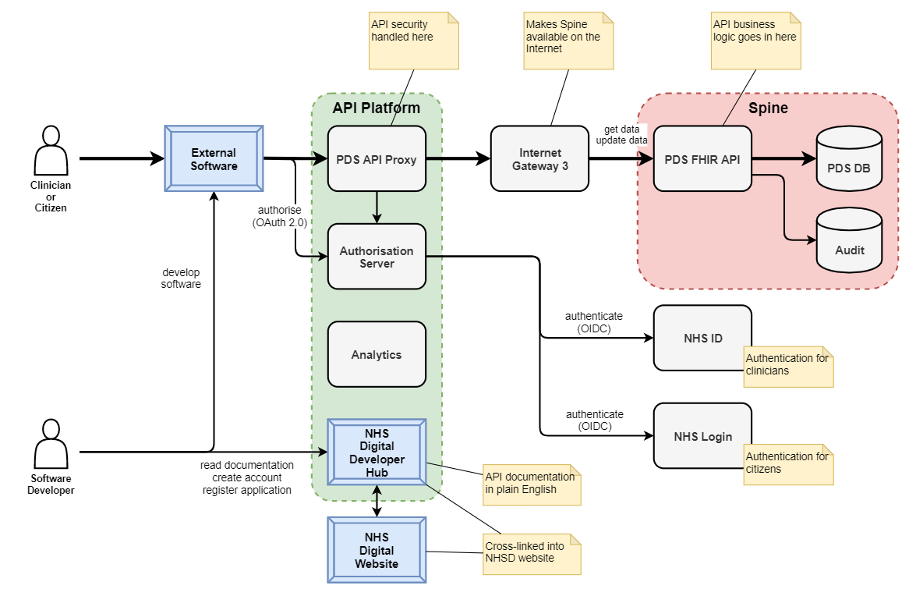
The product
Search
Retrieve
Update
Citizen access is a New Thing
FHIR is an interesting challenge

Slide 8
Developer Hub
Developer Home
General docs
Getting started
Introduction to APIs
API specs
New APIs
Security
Developer account
Register
Manage apps
Legacy APIs
(others)

Slide 9
Developer Hub – home
New Developer area on the NHSD website
Learn how it all works
Learn basic concepts & terminology
View the list of APIs

Slide 10
Developer Hub – getting started
Summary of the end-to-end developer journey
Lots of links to relevant docs

Slide 11
Developer Hub – API catalogue
Example API for learning
Alphabetical search
New FHIR API
Coming soon: filter by type or domain
Existing APIs listed alongside

Slide 12
Developer Hub – API specs
Download spec in OAS format
Interactive sandbox
Left nav shows endpoints and resources
Main panel contains the spec

Slide 13
Workshop
Hello World API – open access
Hello World API – application-restricted
Hello World API – user-restricted
PDS API – sandbox – search
PDS API – sandbox - retrieve

Slide 14
PDS API roadmap
Discovery
Alpha - Spec
Alpha - Sandbox
Private Beta - Production
01/09/19 - 18/09/19
Problem definition
Users and needs
Prototype API spec
User testing
Callable sandbox
Integration test env’t
Production env’t
Assurance process
Iterate Beta
Live
Update patient
Search and retrieve patient
01/01/20 - 31/03/20
19/09/19 - 15/11/19
16/11/19 - 31/12/19
User testing
01/04/20 - 30/09/20
Unauthenticated access (SMSP+)
Citizen access

Slide 15
Product roadmap – other APIs
Work in progress…
ODS – existing FHIR API – move onto API platform
eRS – existing FHIR API – move onto API platform
SCR – depends on GP connect and NRL – funded by platform portfolio
EPS
…and many more

Slide 16
NHS Digital platform strategy
NHSD’s platform ambition is to become the technology partner of choice for the heath and care sector by 2025, enabling the growth of an innovative digital healthcare ecosystem.
Simple
Architecture
Integrated
Technologies
Standardised
Open API’S
Co-creation
Competition
Innovation
National & Local
R&D
Improving Health & Care Services
for professionals, patients & public
Collaborative Culture built on trust

Slide 17
Q&A

Slide 18
Workshop
Tutorial – open access API
Tutorial – application-restricted API
Tutorial – user-restricted API
PDS API – sandbox – search
PDS API – sandbox – retrieve
Display patient details
“Try this API”
Postman
In code
“Try this API”
Postman
In code
“Try this API”
Postman
In code
Display search results as a list

